Slide 1
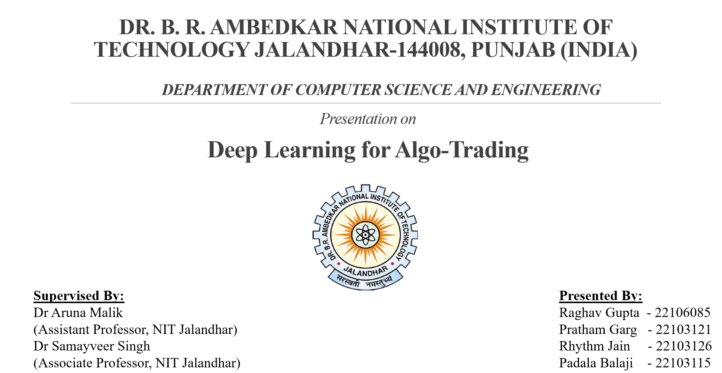
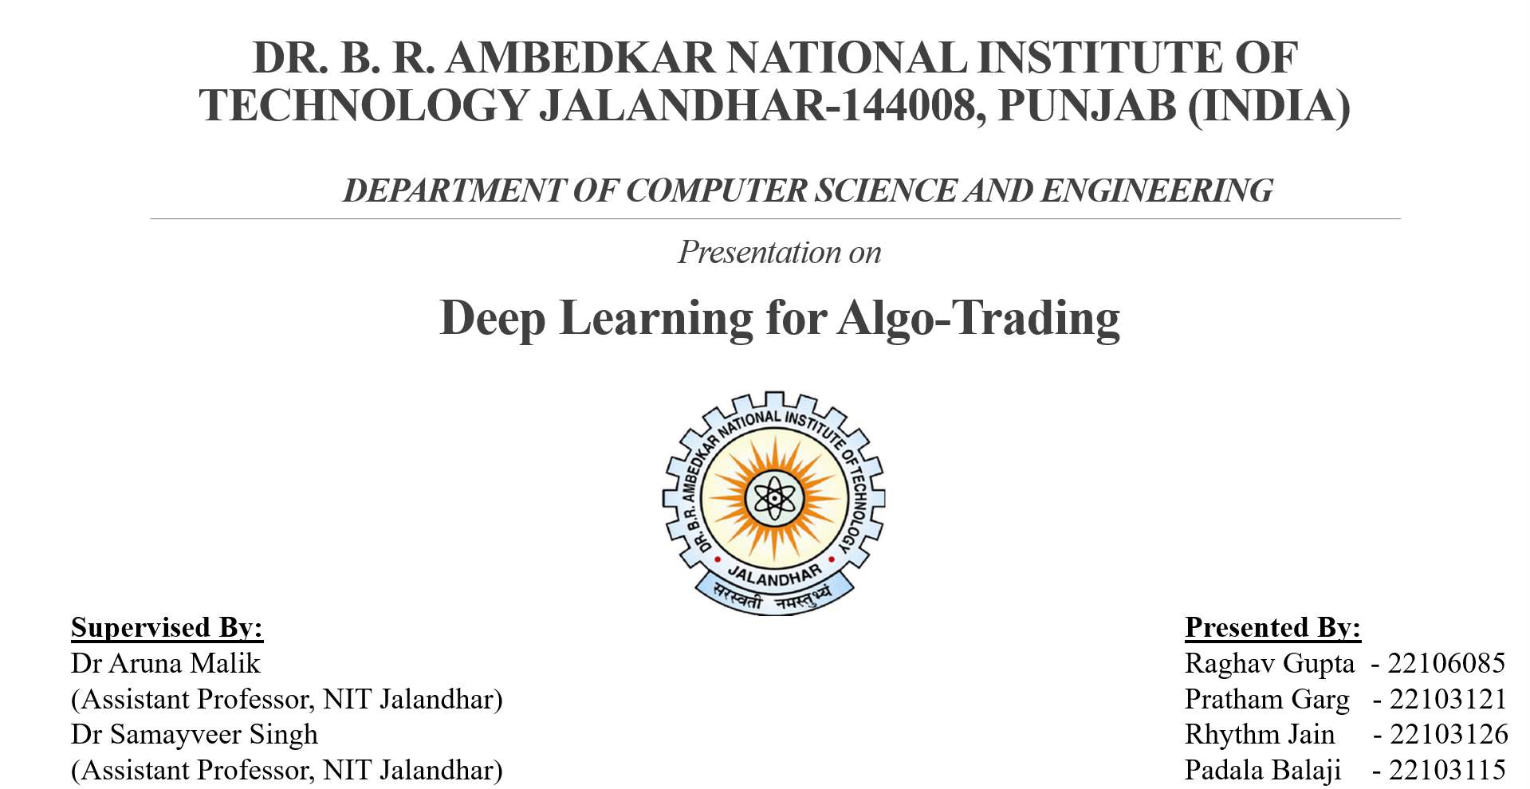
Architecting an Optimization-Based Algorithmic Trading System
A Framework Integrating Probabilistic Forecasting and Deep Reinforcement Learning
College Major Project Proposal

Slide 2
Table of Contents
Problem Overview & Purpose 3
Finance Fundamentals 4
Current Deep Learning Models 5
Problem Statement 6
Research Objectives 7
Current & Proposed Solutions 8 - 9
Conclusion & References 10 - 12

Slide 3
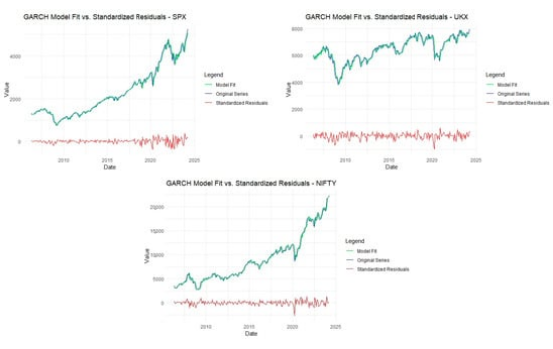
Problem Overview and Purpose
Current algorithmic trading systems face several key challenges:
•
Prediction vs. Optimization: Most models are simple predictors (forecasting prices) but lack the ability to make optimized decisions (Buy/Sell/Hold).
•
Human Mimicry: It is difficult to capture the complex, non-linear decision-making process of an experienced human trader.
•
Risk & Uncertainty: Simple, single-point forecasts (e.g., "Price will be Rs. 105") ignore market uncertainty. A probabilistic forecast (e.g., "70% chance of Rs. 100 - Rs. 110") is superior for risk management.
Fig. 1

Slide 4
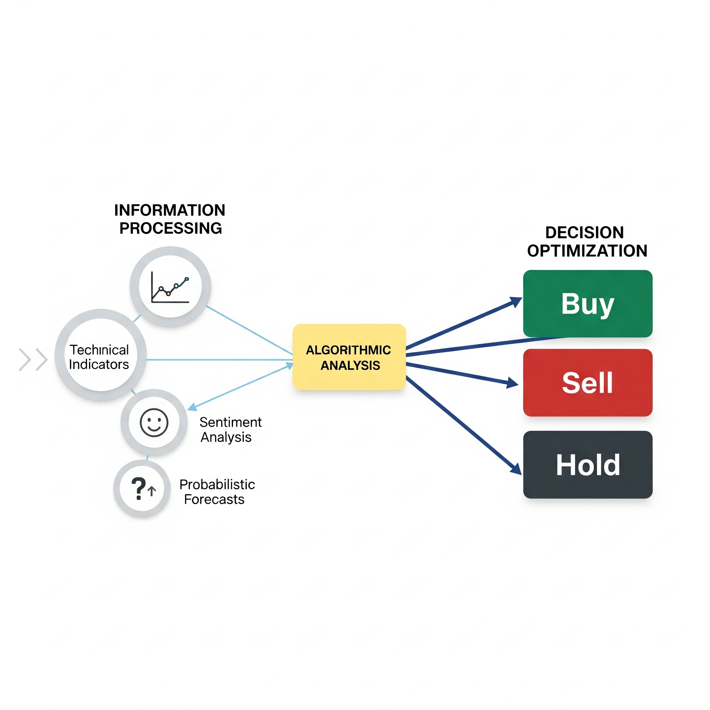
Finance Fundamentals
The Trader's Cognitive Process
A professional trader's behavior is a two-stage process this project aims to mimic:
1.
Analysis (Prediction): The trader forms a mental forecast by reading charts (Technical Indicators) and consuming news (Sentiment Analysis).
2.
Decision (Optimization): The trader executes a trade (Buy/Sell/Hold) based on their forecast and their personal risk tolerance.
Key Indicators
Our system must integrate these same inputs: Technical Indicators (MACD, RSI), Sentiment Analysis, and Probabilistic Forecasts.
Fig. 2

Slide 5
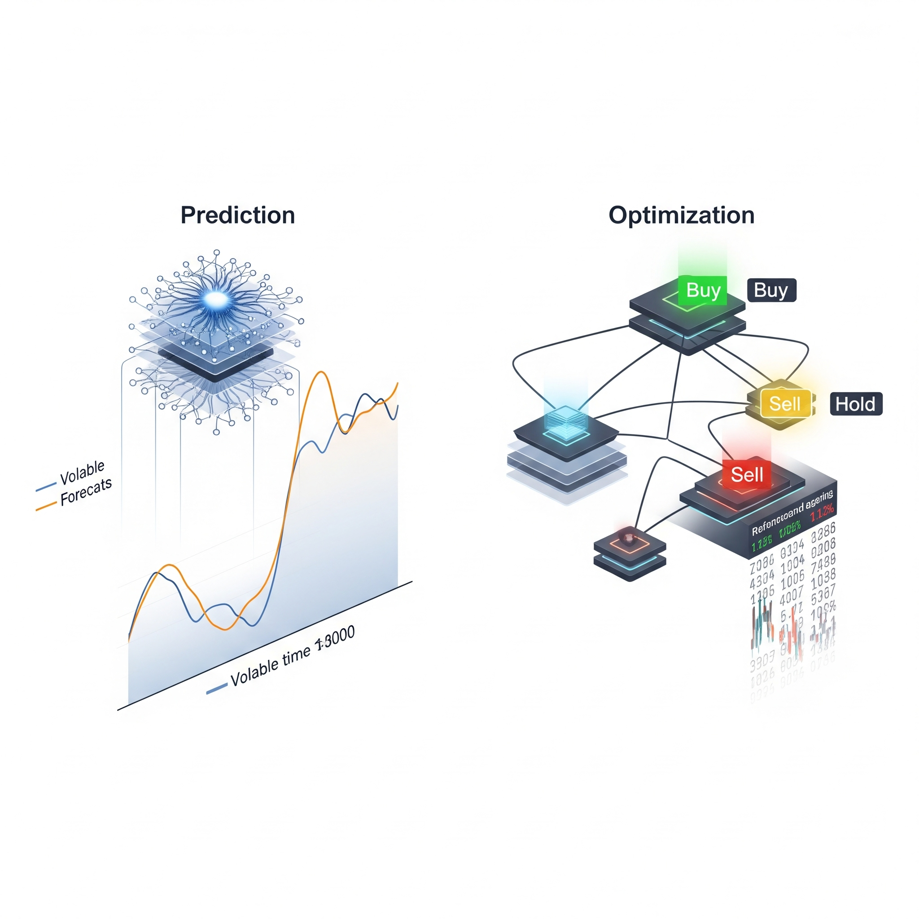
Current DL Models in Finance
Predictive Models
These answer: "What will the price be?"
•
RNN, LSTM, GRU: Standard models for forecasting price trends.
•
DeepAR (Li et al.): An advanced model that provides probabilistic forecasts (a price range with confidence).
•
FinBERT: A language model that analyzes text for financial sentiment.
Optimization Models
These answer: "What should I do?"
•
Deep Reinforcement Learning (DRL): An agent learns an optimal policy (a set of rules) to maximize a reward.
Fig. 3
•
Algorithms: DQN, SARSA, PPO.

Slide 6
Problem Statement
Existing models fail to capture a human trader's ability to integrate diverse data and make optimized, risk-adjusted decisions. Current solutions lack the adaptability to incorporate nuanced trader behavior and rely excessively on historical data.
"
"

Slide 7







Research Objectives
Study
Integrate
Optimize
Analyze
Analyze current modular DL/DRL architectures.
Create a rich state space that inputs trader behavior into a DRL agent.
Use superior models to improve accuracy and risk-adjusted returns (Sharpe Ratio).
Focus on relative data changes (percentages) rather than absolute prices to ensure model robustness.

Slide 8


Current Solutions: A Modular Approach
Layer 1: Data Processing
Layer 2: Decision
The first layer uses predictive models (like LSTM) to forecast price, volatility, and uncertainty. This forms the "analysis" part of a trader's brain.
A Deep Reinforcement Learning (DRL) agent consumes these predictions and learns an optimal policy to maximize a reward.

Slide 9
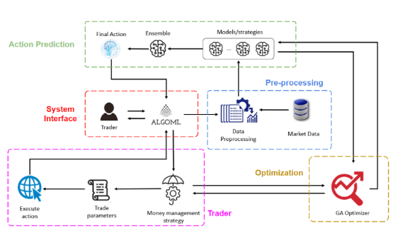
Proposed Solution: An Enhanced Two-Stage System
Data Processing Layer (State Space)
We will build a comprehensive state space that mimics a trader's inputs:
•
Probabilistic Forecast: Use Deep Learning model to process the data.
and find the underlying pattern.
•
Trader Behaviour: Using the Trader’s behaviour like Risk Tolerance and Time frame.
•
Technical: Use of 30+ indicators (RSI, MACD, etc.).
Decision Layer (DRL Agent)
•
Algorithm: Use Proximal Policy Optimization (PPO) like algorithm for its stability and robustness.
•
Reward: Optimize for the Short-Term Sharpe Ratio to ensure risk-adjusted returns.
Fig. 4

Slide 10
Conclusion
This project bridges the gap between simple price prediction and true optimization. By integrating probabilistic forecasts and trader behaviour into a robust DRL agent (PPO), our system mimics the cognitive process of a professional trader to deliver stable, high-performing, risk-adjusted returns.

Slide 11
References
Bhuiyan, M. S. M., et al. (2025). "Deep learning for algorithmic trading: A systematic review of predictive models and optimization strategies." Array, 26.
Huang, Y., et al. (2024). "A novel deep reinforcement learning framework with BILSTM-Attention networks for algorithmic trading." Expert Systems With Applications, 240.
Li, J., et al. (2024). "DeepAR-Attention probabilistic prediction for stock price series." Neural Computing and Applications, 36.

Slide 12



Image Sources
https://pub.mdpi-res.com/jrfm/jrfm-17-00479/article_deploy/html/images/jrfm-17-00479-g001-550.jpg?1730111573
Source: www.mdpi.com
https://pub.mdpi-res.com/fintech/fintech-01-00008/article_deploy/html/images/fintech-01-00008-g001.png?1648380642
Source: www.mdpi.com
https://www.mdpi.com/designs/designs-08-00078/article_deploy/html/images/designs-08-00078-g001.png
Source: www.mdpi.com

Slide 13
Thank You

